Slide 1
COSMIC:
Dispersion simulations with JCM Wave

Slide 2
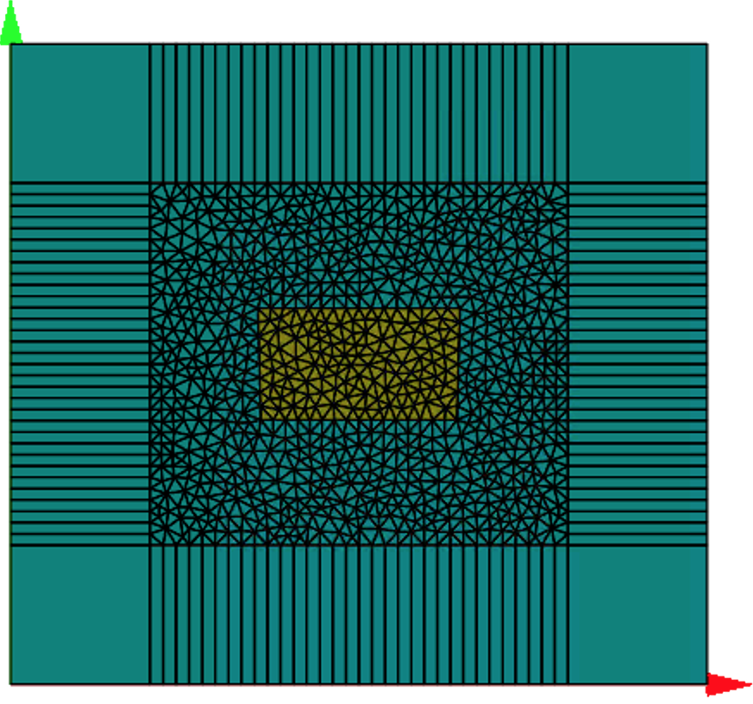
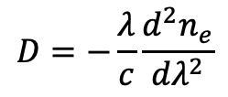
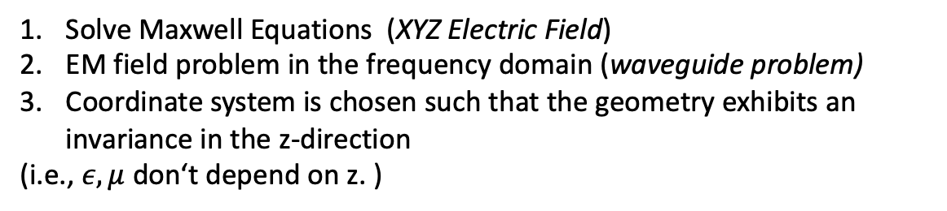
GVD dispersion parameter:
$$D=−\frac{λ}{c}\frac{d^{2}n_{e}}{{dλ}^{2}}$$
Solve Maxwell Equations (XYZ Electric Field)
EM field problem in the frequency domain (waveguide problem)
Coordinate system is chosen such that the geometry exhibits an invariance in the z-direction
(i.e., $ε, μ$ don‘t depend on z. )
It is the aim to find propagating modes which solve Maxwell equations in source-free media and which depend harmonically on z.
Notes:
This means that the electromagnetic field depends harmonically on time with an angular Frequency

Slide 3
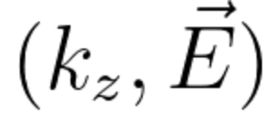
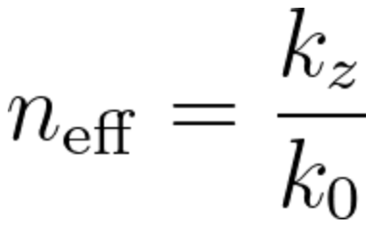
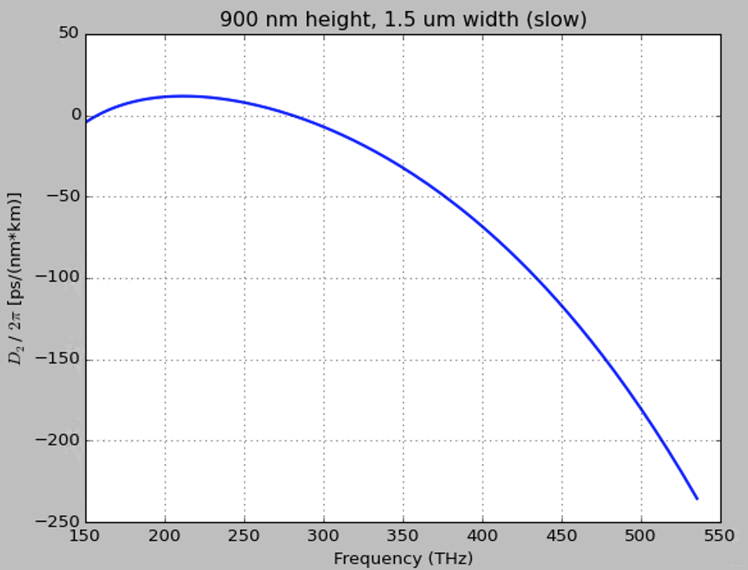
Waveguide equation:
Eigenmode equation with the structure of an eigenvalue problem:
We seek pairs of the propagating constant and the field distribution.
The eigenvalue is given in the form of an effective refractive index:
By making a sweep in wavelength, we can derive the refractive index for each one of them

Slide 4
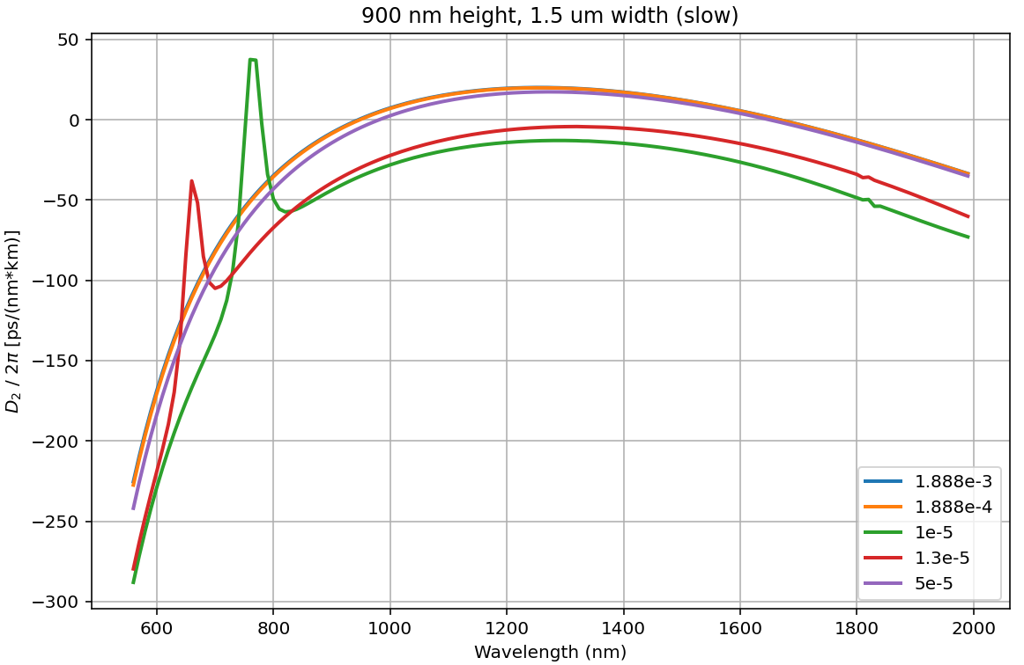
Results

Slide 5
COSMIC:
LLE simulations for microresonators

Slide 6
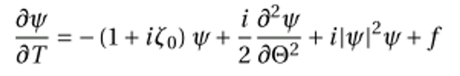
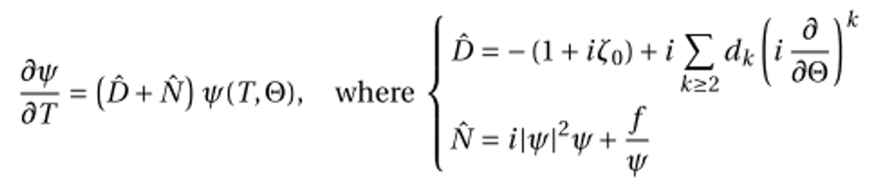
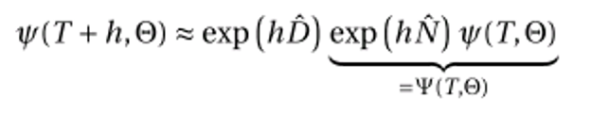
Methods
﻿Propagate Step Adaptive Method
﻿Propagate Split Step Method
Simulates the propagation from instant t to t+h by splitting into two independent steps. One of length h (only nonlinear is applied) and a second step h of pure linear propagation.
Lugiato-Lefever Equation:

Slide 7
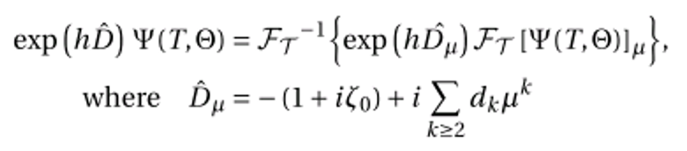
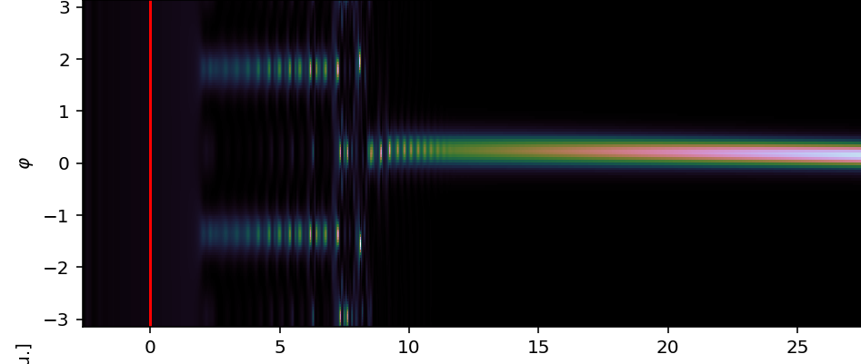
Split step method
If these parameters are given:
Resonator dispersion
Linewidth
Nonlinearity
The operating conditions are defined by
Pump power
Detuning

Slide 8
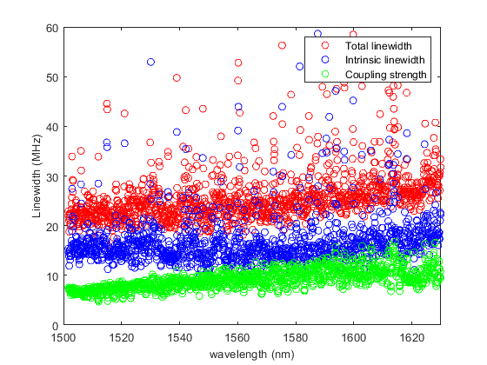
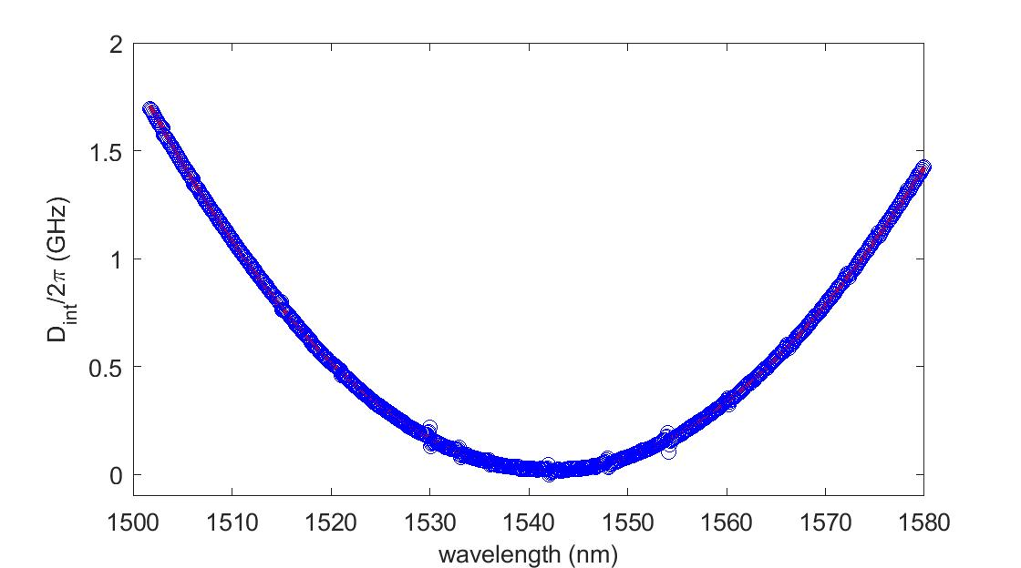
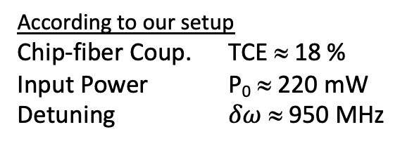
Data for simulations
Chip number: D63_1_12GHz_F13_C12
D1 = 12.131 GHz
D2= 19 MHz
In the range around 1542 nm
Total linewidth κ ≈ 22 MHz
Intrinsic linewidth κ₀ ≈ 14 MHz
Intrinsic Q factor Q₀ ≈ 14 × 10⁶
According to our setup
Chip-fiber Coup. TCE ≈ 18 %
Input Power P₀ ≈ 220 mW
Detuning $δω$ ≈ 950 MHz

Slide 9
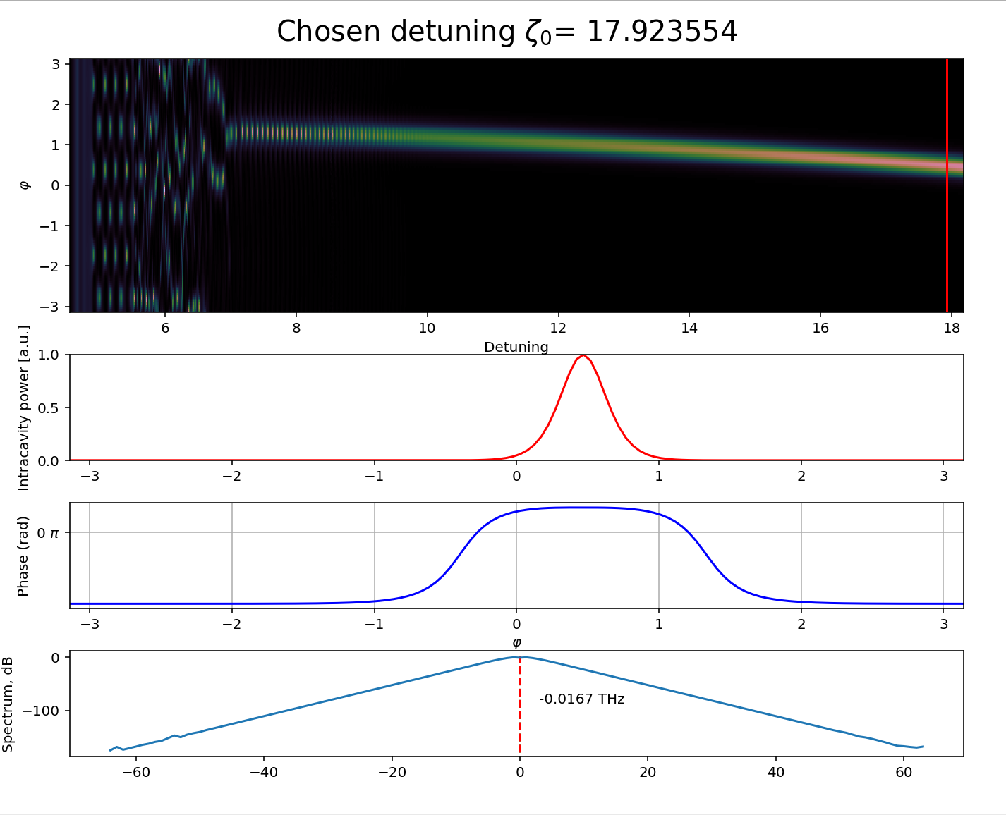
Results from simulations
Mode number

Slide 10
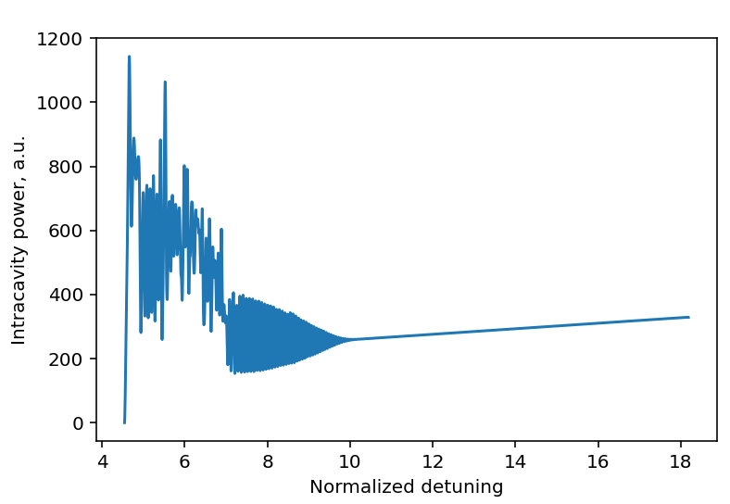
Results from simulations

